Slide 1
Programming Concepts

Slide 2
Conditional Statements:
It is used to control the flow of program based on conditions.
Conditional statements are if, if-else, and elif.
if:
It is used to test a specific condition.
If the condition is true, a block of code will executed.
Syntax:
if expression:
statements

Slide 3
Program:
n=3
if n>0:
print(n, “ is a positive number.”)
print(“This is printed always.”)
n=-1
if n>0:
print(n,” is a positive number.”)
print(“This is also printed always.”)
Output:
3 is a positive number.
This is printed always.
This is also printed always

Slide 4
if-else:
It is similar to if statement except the fact.
If the condition true, if block is executed otherwise else block executed.
Syntax:
if expression:
Statement(s)
else:
Statement(s)
Example:
n=5
if n >= 0:
print(n, “is positive or zero”)
else:
print(n, “is Negative Number”)
Output:
5 is positive or zero

Slide 5
elif statement:
It allows us to check for multiple expressions.
If the condition for if is False, it checks the condition of the next elif block and so on.
If all the conditions are False, the body of else is executed.
if block can have only one else block. But it can have multiple elif blocks.
Syntax:
if expression1:
statement(s)
elif expression2:
statement(s)
elif expression3:
statement(s)
else:
statement(s)

Slide 6
Program:
n=3.4
if n>0:
print(“Positive Number”)
elif n == 0:
print(“Zero”)
else:
print(“Negative Number”)
Output:
Positive Number
Exercise:
#Try this two variations as well n=0 and n=-1

Slide 7
Looping statement:
Used to repeat a specific block of code a known number of times.
It has the following looping statement,
while loop
for loop
nested loop
while loop:
Used to execute block of statements repeatedly until a given condition is satisfied.
Syntax:
while expression:
statement(s)

Slide 8
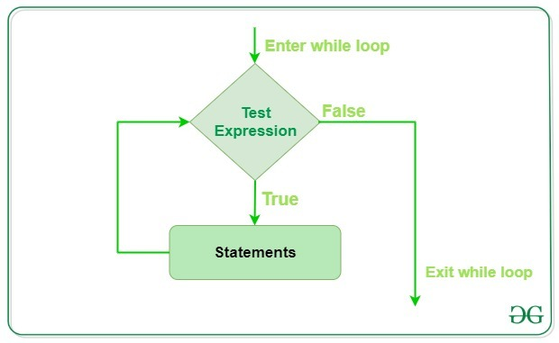

Slide 9
Program:
count=0
while(count<9):
count += 1
print(‘The Count is:’, count)
print(“Good bye!”)
Output:
The Count is: 1
The Count is: 2
The Count is: 3
The Count is: 4
The Count is: 5
The Count is: 6
The Count is: 7
The Count is: 8
The Count is: 9
Good bye!

Slide 10
Else with while loop:
After executing while loop, the else statement will execute.
Syntax:
while expression:
statement(s)
else:
statement(s)

Slide 11
Program:
i=1
while i < 6:
print(i)
i += 1
else:
print(“i is no longer less than 6”)
Output:
1
2
3
4
5
i is no longer less than 6

Slide 12
for loop:
It is used to iterate over a sequence(list, tuple, set, dictionary, and string)
Syntax:
for iterator-var in sequence:
statement(s)
Program:
numbers=[6,5,4,1,2,3,7,8,9]
sum=0
for val in numbers:
sum=sum+val
print(“The sum is”, sum)
print(“The sum is”, sum)
Output:
The sum is 6
The sum is 11
The sum is 15
The sum is 16
The sum is 18
The sum is 21
The sum is 28
The sum is 36
The sum is 45
The sum is 45

Slide 13
range() function:
It returns sequence of numbers, in a given range.
Syntax:
range(start, stop, step)
where,
start -> start value of the sequence
stop -> end value of the sequence (n-1)
step -> difference b/w number in the sequence
Example:
>>>range(10)
range(0, 10)
>>> list(range(10))
[0, 1, 2, 3, 4, 5, 6, 7, 8, 9]
>>> list(range(2,8))
[2, 3, 4, 5, 6, 7]
>>> list(range(2,20,3))
[2, 5, 8, 11, 14, 17]

Slide 14
Program:
list = [‘Apple’, ‘Orange’ , ‘Cherry’]
for i in range(len(list)):
print(“I like”, list[i])
Output:
I like Apple
I like Orange
I like Cherry
Example:
>>>range(10)
range(0, 10)
>>>list(range(10))
[0, 1, 2, 3, 4, 5, 6, 7, 8, 9]
>>>set(range(10))
{0, 1, 2, 3, 4, 5, 6, 7, 8, 9}
>>>tuple(range(10))
(0, 1, 2, 3, 4, 5, 6, 7, 8, 9)
>>>tuple(range(10,15))
(10, 11, 12, 13, 14)
>>>set(range(1,15,2))
{1, 3, 5, 7, 9, 11, 13}
>>>set(range(1,15,3))
{1, 4, 7, 10, 13}

Slide 15
for loop with else:
After executing for loop, the else block will executed.
Syntax:
for iterator-var in sequence:
statement(s)
else:
statement(s)
Program:
digits = [0,1,5]
for i in digits:
print(i)
else:
print(“No items left.”)
Output:
0
1
5
No items left.

Slide 16
Nested loop:
One loop is placed inside the another loop.
Syntax:
Outer-loop expression:
inner-loop expression:
statement inside inner-loop
statement inside outer-loop
Syntax – nested for loop:-
for iterator-var in sequence:
for iterator-var in sequence:
statement(s)
statement(s)
Program nested for-loop:
x = [1,2]
y = [4,5]
for i in x:
for j in y:
print(i, j)
Output:
1 4
1 5
2 4
2 5

Slide 17
Nested while loop Program:
x = [1,2]
y = [4,5]
i = 0
while i < len(x):
j = 0
while j < len(y):
print(x[i], y[j])
j+=1
i+=1
print()
Output:
1 4
1 5
2 4
2 5
Exercise:
Write a program to display 9th table using while loop.

Slide 18
Loop control statements:
It is change the flow of execution.
It is used to skip an iteration or stop the execution.
It has 3 types. They are,
break statement
continue statement
pass statement
Continue statement:
It skip the element when the external condition is met.
Program:
for var in "Geeksforgeeks":
if var == "e":
continue
print(var)
Output:
G
k
s
f
o
r
g
k
s

Slide 19
Break statement:
It exit the loop when external condition is met.
Program:
var = 10
while var>0:
var-=1
if var == 5:
break
print(var)
print("The End")
Output:
9
8
7
6
The End

Slide 20
Pass statement:
We use pass statement to write empty loops.
Pass is also used for empty control statement, function and classes.
Program:
for letter in 'Python':
if letter == 'h':
pass
print ('This is pass block')
print ('Current Letter :', letter)
print ("Good bye!")
Output:
Current Letter : P
Current Letter : y
Current Letter : t
This is pass block
Current Letter : h
Current Letter : o
Current Letter : n
Good bye!

Slide 21
Exercise:
Write a program to check if a number is prime or not
Write a python program to find the factorial of a number provided by the user
Write a program in python to check whether the string is palindrome or not?
Write a program in python to check whether the number is Armstrong or not?
Write a python program to print Fibonacci Sequence.

